Slide 1
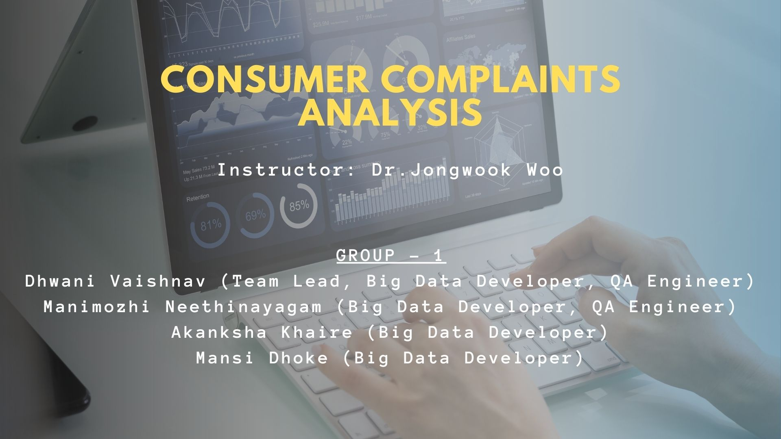

Slide 2









Agenda
Introduction
Cluster Specification
Project Workflow
Hive Tables for Visualizations
Analysis & Visualization
Challenges / Solutions
Dataset Details
Conclusion

Slide 3


Introduction
Some Insights on Dataset
U.S. government agency dedicated to consumer protection in BANKS and Financial Institutions.
Provides data on finance-related issues faced by consumers.
Project Introduction
Analyzed consumer complaints in the USA.
Conducted year-on-year growth analysis to identify trends.
Analyzed complaints statistics specifically for California.
Performed sentiment analysis on consumers' complaints sentiment.
Focused on Ngram Text Processing for meaningful insights from Complaints Narrative column.
Project GitHub link
https://github.com/dvaishna/BigDataDriven_Consumer_Complaints_Analysis

Slide 4

Dataset Details
DATASET NAME: Consumer Financial Protection Bureau Dataset
DATASET URL: https://catalog.data.gov/dataset/consumer-complaint-database
SIZE: 3.6 GB
NUMBER OF FILES: 1
FORMAT: JSON
COUNTRY CONSIDERED: USA
DATASET COLUMNS: “Date received”, “Product”, “Sub-product”, “Issue”, “Sub-issue”, “Consumer complaint narrative”, “Company public response”, “Company”, “ZIP code”, “Tags”, “Consumer consent provided?”, “Submitted via”, “Date sent to company”, “Company response to consumer”, “Timely response?”, “Consumer disputed?”, “Complaint Id”

Slide 5
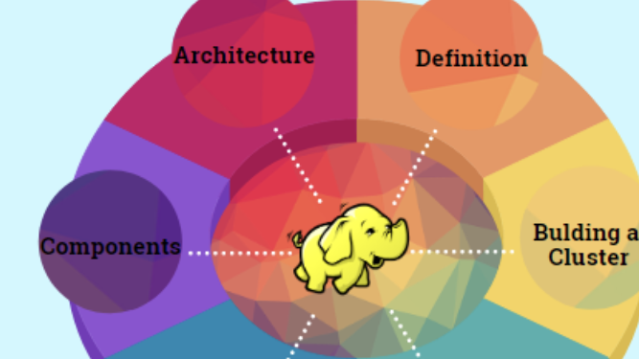
Hadoop Cluster Specification
CLUSTER VERSION:​ ​Hadoop 3.1.2
CLUSTER NODES:​ 5 (2 master nodes & 3 data nodes)
MEMORY SIZE:​ Memory Used – 367.68 GB, Memory Remaining – 20.96 GB
CPU SPEED:​ ​1995.312 MHz

Slide 6
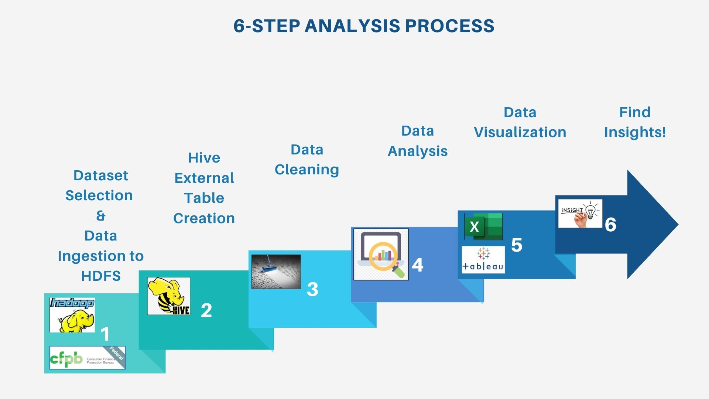
Dataset Selection & Data Ingestion to HDFS
Data Cleaning
Data Analysis
Data Visualization
6-Step Analysis Process
Hive External Table Creation
Find Insights!

Slide 7
Hive Tables for Visualizations
VISUALIZATION 1
Top Product
Product
No of Complaints
Top Companies
Company
No of Complaints
Top Issue
Issue
No of Complaints
Submitted Via
State
Submitted Via Medium
No of Complaints
Consumer Complaint
Complaint ID
Date received
Product
Sub-product
Issue
Sub-issue
Consumer complaint narrative
Company public response
Company
State
ZIP code
Tags
Consumer consent provided?
Submitted via
Date sent to company
Company response to consumer
Timely response?
Consumer disputed?
VISUALIZATION 2
Complaints by Date
Date Received
No of Complaints
EXTERNAL BASE TABLE
HIVE TEXT PROCESSING
State Table
Complaint ID
Date Received
Product
Company
Issue
State
Zip
VISUALIZATION 3
VISUALIZATION 5
Tables For Sentiment Analysis
CA Product
State
No of Complaints
Product
CA Company
Company
No of Complaints
VISUALIZATION 4
CA Company Public Response
Company
Company Response

Slide 8
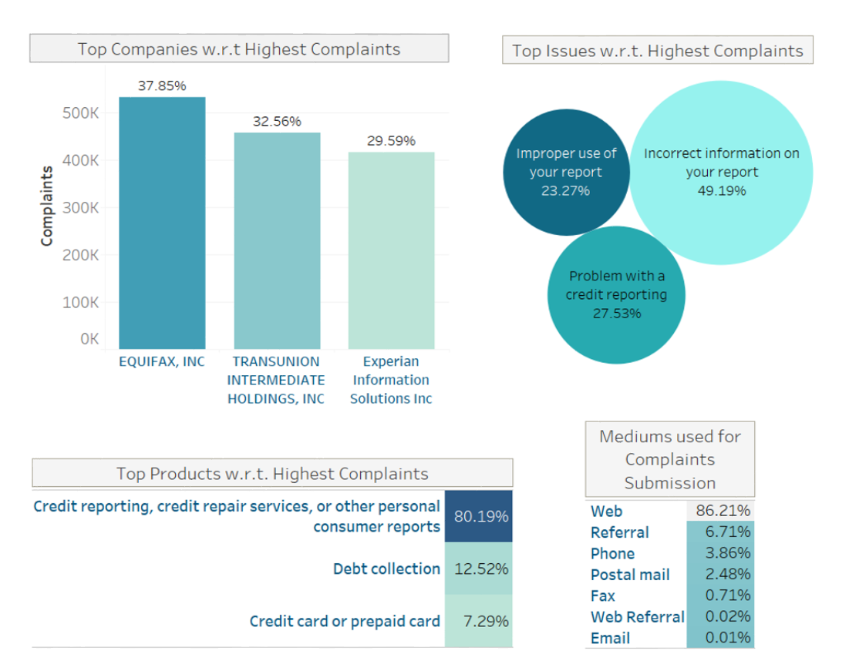
Overall Complaints Statistics
Equifax, Inc received approx. 38% complaints in last 3 years.
Credit reporting garnered approx. 80% complaints.
Incorrect Information on the report received approx. 49% complaints.
Out of all the complaints, approx. 86% complaints are raised using CFPB website.

Slide 9
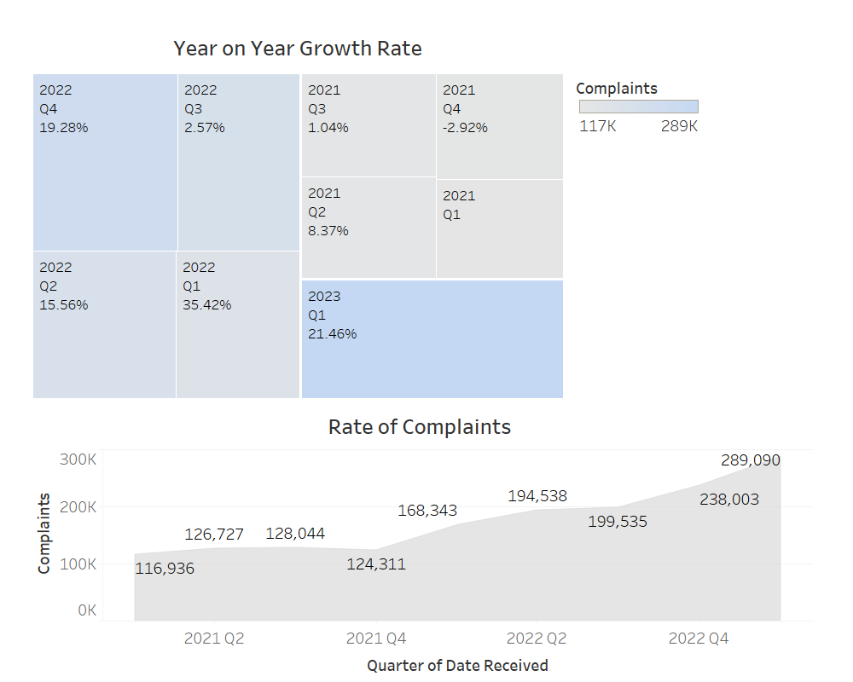
Year-On-Year Complaints Statistics (2021 to 2023)
The number of overall complaints increased significantly from 117K to 289K
Year | Quarter | Change | % Diff
2021 | Q2 |  | 8%
2021 | Q3 |  | 1%
2021 | Q4 |  | 3%
2022 | Q1 |  | 35%
2022 | Q2 |  | 15%
2022 | Q3 |  | 3%
2022 | Q4 |  | 19%
2023 | Q1 |  | 21%

Slide 10
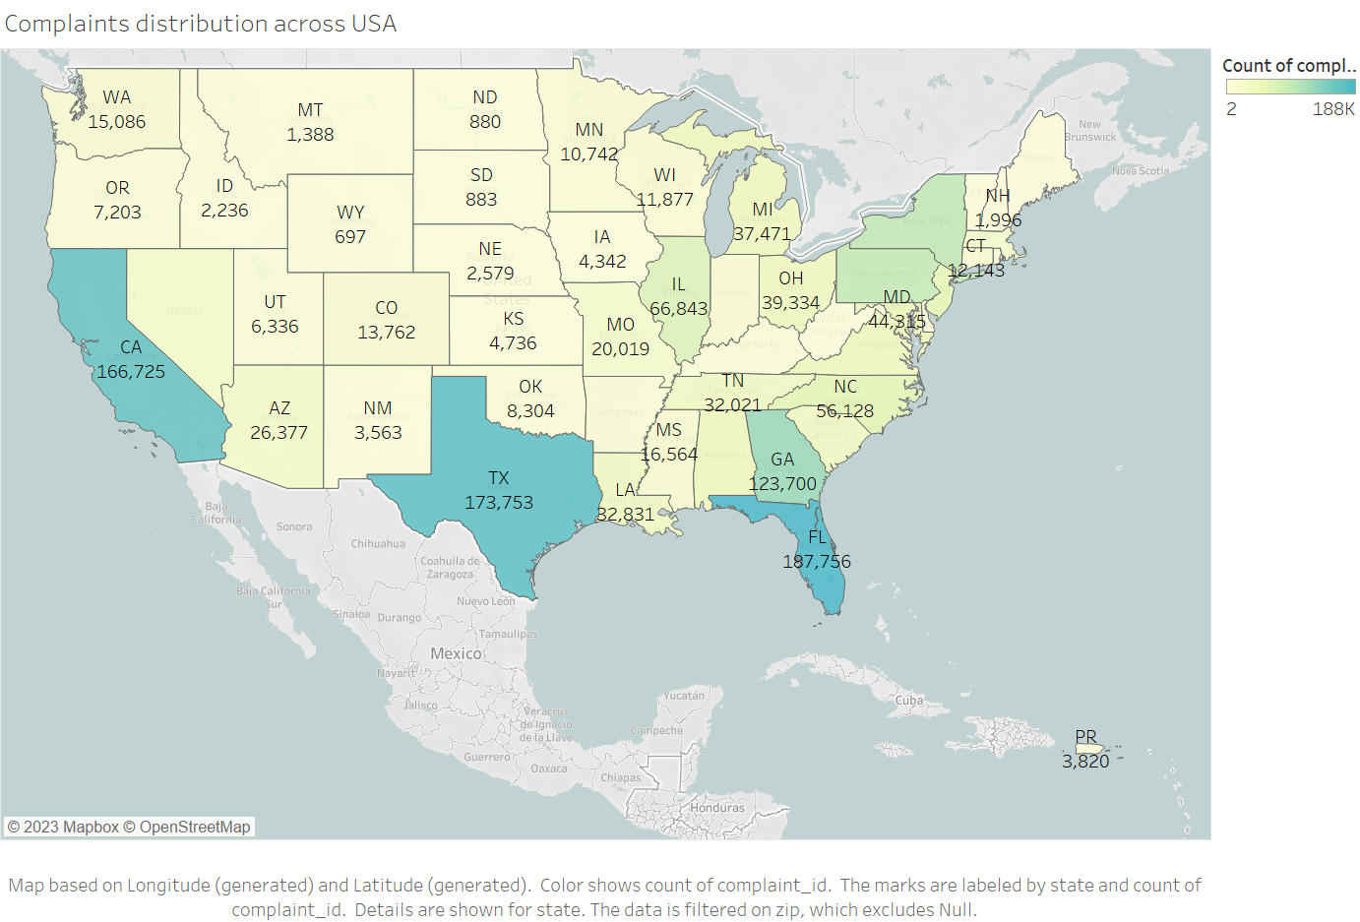
State Based Statistics
Consumers in Florida raised the highest complaints with approx. 187K complaints
Followed by is Texas with approx. 174K complaints.
California is the third state with approx. 166K complaints
Wyoming is the state with the lowest complaints - only 697!

Slide 11
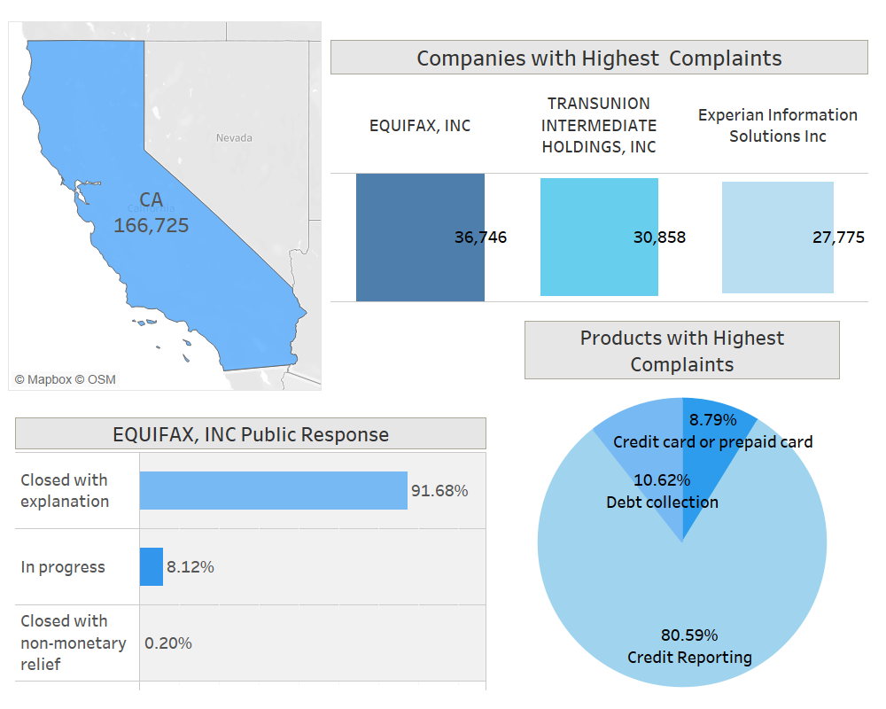
California Complaints Statistics
EQUIFAX, INC has received the highest complaints for California too!
Credit reporting has almost 8 times higher complaints rate than the other products/services EQUIFAX Inc offers.
Approx. 91% complaints have been closed with an explanation
Just 0.2% complaints are closed without any monitory relief.

Slide 12
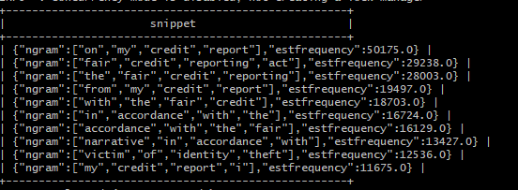

Complaints Narrative - NGram Text Processing
"Victim of identity theft" appears frequently in the list, indicating a significant number of consumers faced this issue.
EQUIFAX, INC. needs to address Identity Theft in its credit reporting services.

Slide 13
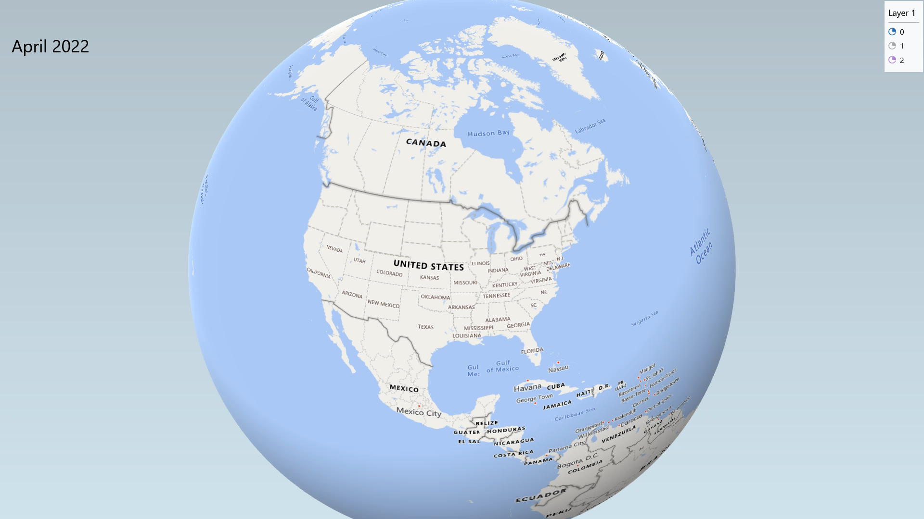
Complaints Narrative Sentiment Analysis
Negative = 0
Neutral = 1
Positive = 2

Slide 14



Challenges And Solutions
Difficulties in handling CSV file format after uploading the data in Hive.
The Complaints Narrative field contained various special characters that made NGram Text Processing challenging.
Limited measures in dataset.
To overcome this, we switched to the JSON format.
We were able to solve this issue by converting the content to JSON format.
Identified patterns, trends, and relationships using the number of complaints as a measure.

Slide 15

The company that received the highest number of complaints related to credit reporting is EQUIFAX, INC.
The product reported by consumers in the Credit Reporting category is Identity Theft.
Florida has the highest number of reported complaints, followed by Texas & California.
The general sentiment expressed in the complaints is NEGATIVE.
Most consumers chose the WEBSITE as their preferred medium for filing complaints.
Conclusion

Slide 16


